Slide 1

Unit-02 CSS
Web Technology – I
DU#2301CS363
Prof. Dharmik P. Vasiyani
Computer Engineering Department
dharmik.vasiyani@darshan.ac.in
9924664064

Slide 2

Outline HTML
Web Design Issues
Planning a website
Effective Navigation
What is CSS?
Types of CSS
Selectors
Properties
Background
Font
Text
Float
Layer
The Box Model
CSS3
Looping

Slide 3
Web Design Issues
Browser & Operating Systems
Bandwidth and Cache
Display Resolution
Look & Feel
Page Layout and Linking
Locating Information
Making Design user-Centric
Sitemap

Slide 4
a) Browser & Operating Systems
Web pages are written using different HTML tags and viewed in browser window.
The different browsers and their versions greatly affect the way a page is rendered, as different browsers sometimes interpret same HTML tag in a different way.
Different versions of HTML also support different sets of tags.
The support for different tags also varies across the different browsers and their versions.
Same browser may work slightly different on different operating system and hardware platform.
To make a web page portable, test it on different browsers on different operating systems.

Slide 5
b) Bandwidth and Cache
Users have different connection speed, i.e. bandwidth, to access the Web sites.
Connection speed plays an important role in designing web pages, if user has low bandwidth connection and a web page contains too many images, it takes more time to download.
Generally, users have no patience to wait for longer time than 10-15 seconds and move to other site without looking at contents of your web page.
Browser provides temporary memory called cache to store the graphics.
When user gives the URL of the web page for the first time, HTML file together with all the graphics files referred in a page is downloaded and displayed.

Slide 6
c) Display Resolution
Display resolution is another important factor affecting the Web page design, as we do not have any control on display resolution of the monitors on which user views our pages.
Display or screen resolution is measured in terms of pixels and common resolutions are 800 X 600 and 1024 X 786.
We have three choices for Web page design.
Design a web page with fixed resolution.
Make a flexible design using HTML table to fit into different resolution.
If the page is displayed on a monitor with a higher resolution, the page is displayed on left hand side and some part on the right-hand side remains blank. We can use centered design to display page properly.
Ideally we should use some frameworks for designing like Bootstrap/Material design.

Slide 7
d) Look & Feel & e) Page Layout and Linking
Look & Feel
Look and feel of the website decides the overall appearance of the website.
It includes all the design aspects such as
Web site theme
Web typography
Graphics
Visual structure
Navigation etc…
Page Layout and Linking
Website contains of individual web pages that are linked together using various navigational links.
Page layout defines the visual structure of the page and divides the page area into different parts to present the information of varying importance.
Page layout allows the designer to distribute the contents on a page such that visitor can view it easily and find necessary details.

Slide 8
f) Locating Information & g) Making Design user-centric
Locating Information
Webpage is viewed on a computer screen and the screen can be divided into five major areas such as center, top, right, bottom and left in this particular order.
The first major area of importance in terms of users viewing pattern is the center, then top, right, bottom and left in this particular order
Making Design user-centric
It is very difficult for any Web designer to predict the exact behavior of the Web site users.
However, idea of general behavior of common user helps in making design of the Web site user centric.
Users either scan the information on the web page to find the section of their interest or read the information to get details.

Slide 9
h) Sitemap
A Sitemap is a model of a website's content designed to help both users and search engines navigate the site.
Many a times Web sites are too complex as there are a large number of sections and each section contains many pages.
It becomes difficult for visitors to quickly move from one part to other.
Once the user selects a particular section and pages in that section, user gets confused about where he/she is and where to go from there.
To make it simple, keep your hierarchy of information to few levels or provide the navigation bar on each page to jump directly to a particular section.

Slide 10
Planning a Website
The most important activity in a website development is planning.
To achieve higher success of the website in terms of user satisfaction, better planning is needed.
Before we start developing a website, we should ask question such as,
Why are we developing this website?
What do we achieve by developing this website?
Who are the people who will use this website?
What are the information contents?
How are these contents organized? What are the possible ways?

Slide 11
Effective Navigation
The most important design element in the web design after page layout is navigation design.
Navigation means the ways to move from one page to another page in a Web site using hyperlinks provided on the page.
If navigation design is not proper then user feels the problem in moving around the pages in your site in a desired manner or gets confused and leaves the site.
Tips for Effective Navigation:
Navigation links are either text based, i.e. a word or a phrase, or graphical, i.e. a image.
Navigation links should be clear and meaningful.
It should be consistent.
Link should be understandable.
Organize the links such that contents are grouped logically.
Provide search link, if necessary, usually on top of the page.
Use common links such as ‘about us’ or ‘contact us’.
Provide the way to return to first page.
Provide the user with information regarding location.
Horizontal navigation bar can be provided on each page to directly jump to any section.

Slide 12
What is CSS?
Cascading Style Sheets, fondly referred to as CSS, is a simple design language intended to simplify the process of making web pages presentable.
CSS defines layout of HTML documents. For example, CSS covers Fonts, colors, margins, lines, height, width, background images, advanced positions and many other things.
Importance of CSS :
CSS defines HOW HTML elements are to be displayed.
Styles are normally saved in external .css files.
External style sheets enable you to change the appearance and layout of all the pages in a Web site, just by editing one single file.
Advantages :
Improves Website Presentation
External CSS makes Updates Easier and Smoother
External CSS helps Web Pages Load Faster
Disadvantages :
Browser Dependent
Difficult to retrofit in old websites

Slide 13
Basic Syntax of CSS
A CSS rule has two main parts: a selector, and one or more declarations
The selector can be HTML element, id or class.
Each declaration consists of a property and a value.
The property is the style attribute you want to change. Each property has a value.
Selector
Declaration 1
Declaration 2
h1
{color:blue; font-size: 12px;}
property
value
property
value

Slide 14
Different ways to write CSS
There are three ways of writing a style sheet:
Inline Style
Internal/Embedded Style sheet
External Style Sheet

Slide 15
1) Inline Style
It is possible to place CSS right in your HTML code, and this method of CSS usage is referred to as inline css.
Inline CSS has the highest priority out of external, internal, and inline CSS.
This means that you can override styles that are defined in external or internal by using inline CSS.
If you want to add a style inside an HTML element all you have to do is specify the desired CSS properties with the style HTML attribute.
Example:
HTML
<p style="background: blue; color: white;"> My Inline CSS </p>

Slide 16
2) Internal Style Sheet
This type of CSS is only for Single Web Page.
When using internal CSS, we must add a new tag, <style>, inside the <head> tag.
The HTML code below contains an example of <style>'s usage.
HTML
<html><head>
<style type="text/css">
p{ color: red;}
</style>
</head><body>
<p>Your page's content!</p></body>
</html>

Slide 17
3) External Style Sheet
When using CSS it is preferable to keep the CSS separate from your HTML.
Placing CSS in a separate file allows the web designer to completely differentiate between content (HTML) and design (CSS).
External CSS is a file that contains only CSS code and is saved with a ".css" file extension.
This CSS file is then referenced in your HTML using the <link> instead of <style>.
Demo.html
<html>
<head>
<link rel=“stylesheet” type=“text/css” href=“test.css”>
</head>
<body>
<p> Hello Friends </p>
<p id=“para1”> How are you? </p>
</body>
</html>
test.css
#para1{
text-align: center;
}
p
{
color : blue;
}
Output
Hello Friends
How are you?

Slide 18
3) External Style Sheet (Cont.)
Advantages:
It keeps your website design and content separate.
It's much easier to reuse your CSS code if you have it in a separate file. Instead of typing the same CSS code on every web page you have, simply have many pages refer to a single CSS file with the "link" tag.
You can make drastic changes to your web pages with just a few changes in a single CSS file.

Slide 19
The “id” selector
The id selector is used to specify a style for a single, unique element.
The id selector uses the id attribute of the HTML element, and is defined with a "#“ in css.
The style rule below will be applied to the element with id="para1":
HTML
<h1 id=“para1”>
Hello Friends
</h1>
<h1>
How are you
</h1>
CSS
#para1{
color: blue;
}
Output
Hello Friends
How are you

Slide 20
The “class” selector
The class selector is used to specify a style for a group of elements.
The class selector uses the HTML class attribute, and is defined with a ".“ in css.
HTML
<h1 class=“myClass”>
Hello Friends
</h1>
<h1>
How are you
</h1>
<h1 class=“myClass”>
How are you
</h1>
CSS
.myClass{
color: blue;
}
Output
Hello Friends
How are you
How are you

Slide 21
Assign Multiple Classes
We can apply different class to same html element by giving space separated class names in the class attribute:
Demo.html
<html>
<head>
<link rel=“stylesheet” type=“text/css” href=“test.css”>
</head>
<body>
<h1 class=“class1 class2”>
How are you?
</h1>
</body>
</html>
test.css
. class1
{
color : blue;
}
. class2
{
text-align : center;
}
Output
How are you?

Slide 22
Multiple Selection
We can apply same css to multiple selectors using comma separated selector list, for example :
Demo.html
<html>
<head>
<link rel=“stylesheet” type=“text/css” href=“test.css”>
</head>
<body>
<p> Hello Friends </p>
<h1> How are you? </h1>
</body>
</html>
test.css
p, h1
{
color : blue;
}
Output
Hello Friends
How are you?

Slide 23
Multi-level Selection
We can use hierarchical path to target html element by space separated element/class/id names, for example :
Demo.html
<html>
<head>
<link rel=“stylesheet” type=“text/css” href=“test.css”>
</head>
<body>
<h1>Hello Friends…</h1>
<div>
<h1>How are you?</h1>
</div>
</body>
</html>
test.css
div h1
{
color : blue;
}
Output
Hello Friends…
How are you?

Slide 24
Multi-level Selection
The child selector (>) targets elements that are direct children of a specified parent element in the HTML structure.
Use Cases:
Formatting list items in navigation menus.
Styling table rows and cells.
Customizing form elements within specific containers.
Syntax
parentElement > childElement {
/* CSS styles */
}
test.css
ul > li {
color: blue;
font-weight: bold;
}

Slide 25
Background Property
Background Color (background-color)
Background Image (background-image)
Background Image Repeat (background-repeat)
Fixed Background Image (background-attachment)
Background Image Positioning (background-position)
Property Name

Slide 26
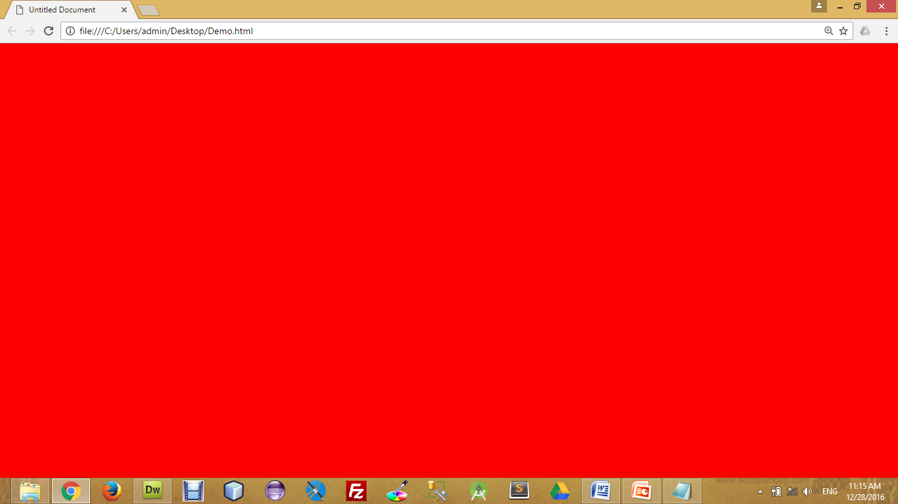
Background Color
The background-color property specifies the background color of an element.
The background color of a page is defined in the body selector:
Below is example of CSS backgrounds
test.css
body
{
background-color : red;
background-color : #FF0000;
background-color : rgb(255,0,0);
}

Slide 27

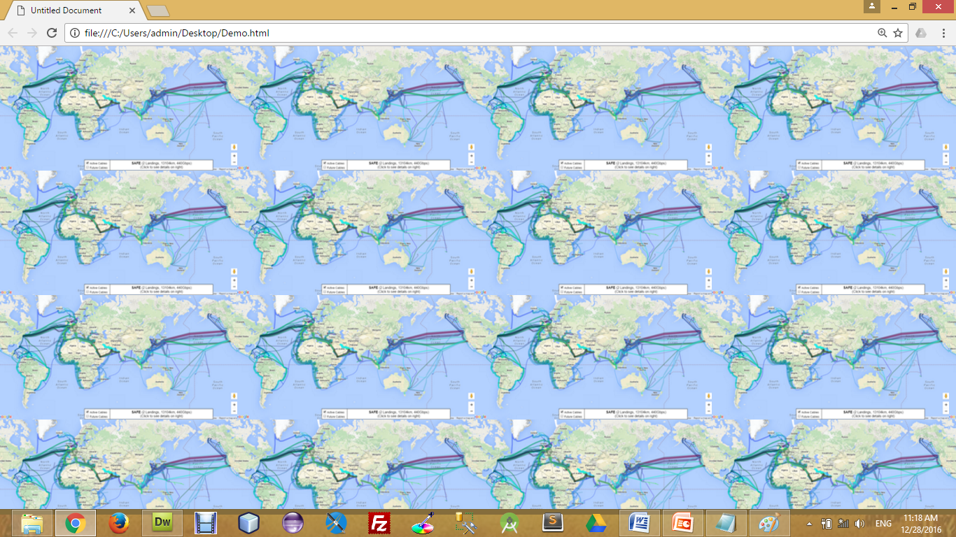
Background Image
The background-image property specifies an image to use as the background of an element.
For Example,
test.css
body
{
background-image : url(‘pathToImage.jpg’);
}

Slide 28
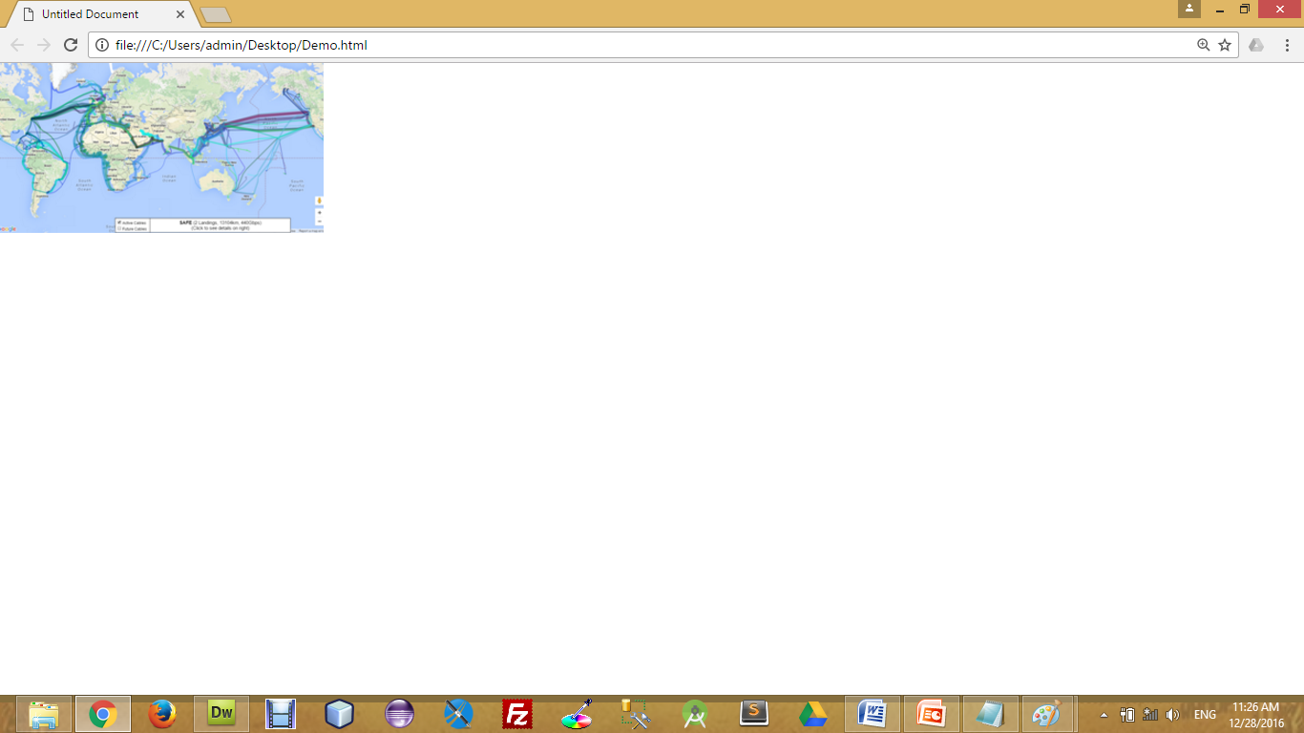
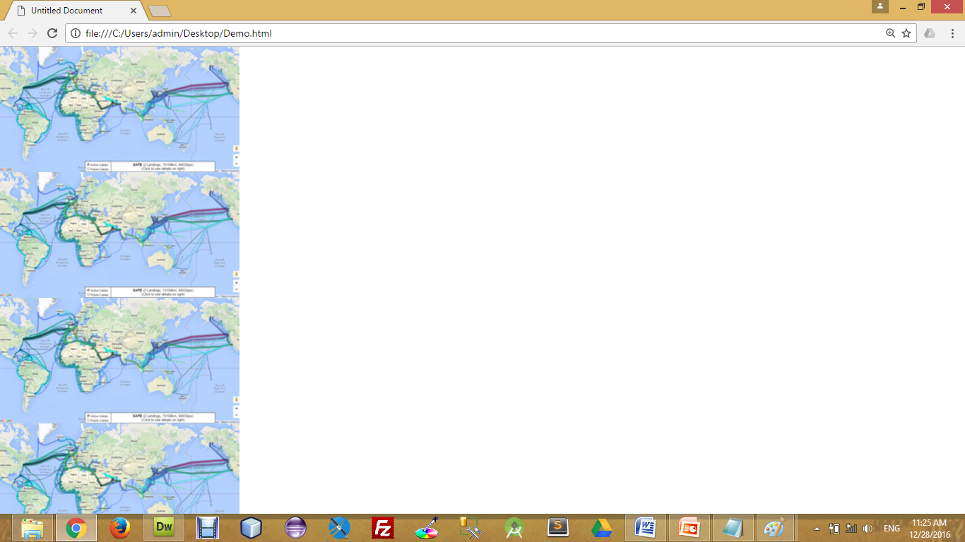
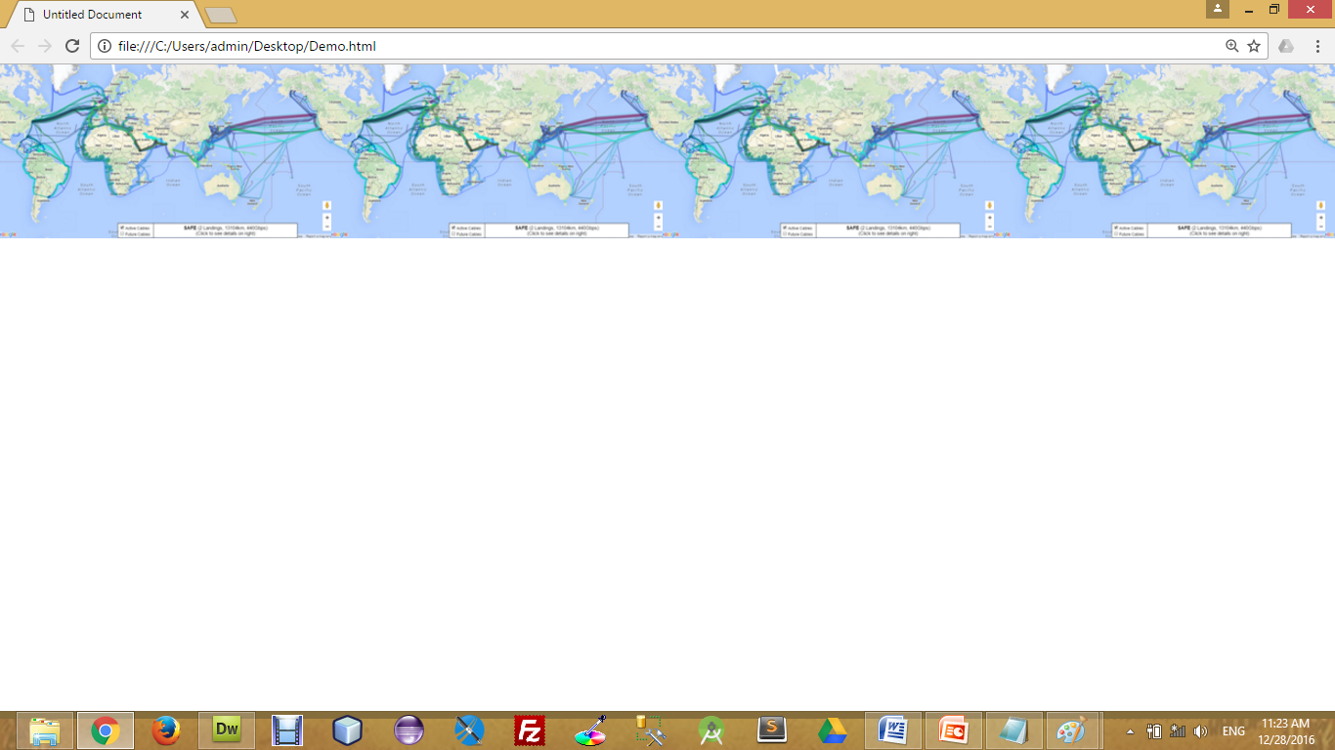
Background Image Repeat
You can have a background image repeat vertically (y-axis), horizontally (x-axis), in both directions, or in neither direction.
test.css
body
{
background-image : url(‘pathToImage.jpg’);
background-repeat : repeat;
background-repeat : repeat-x;
background-repeat : repeat-y;
background-repeat : no-repeat;
}

Slide 29
Fixed Background Image
The background-attachment property sets whether a background image is fixed or scrolls with the rest of the page.
For Example,
test.css
body
{
background-image : url(‘pathToImage.jpg’);
background-repeat : no-repeat;
background-attachment : fixed;
}

Slide 30
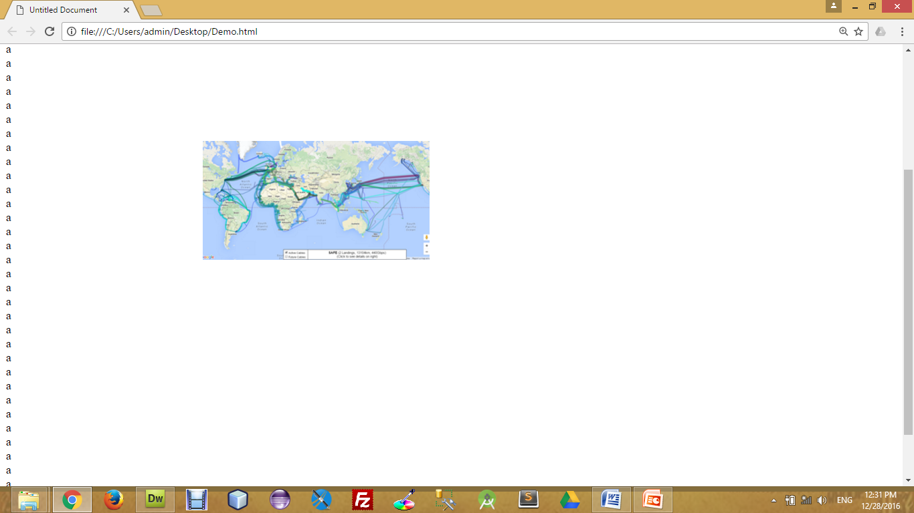
Background Image Positioning
The background-position property sets the starting position of a background image.
test.css
body
{
background-image : url(‘pathToImage.jpg’);
background-repeat : no-repeat;
background-position: 20px 10px;
background-position: 30%30%;
background-position: top center;
}

Slide 31
CSS Font
CSS font properties define the font family, boldness, size, and the style of a text.
Font Color (color)
Font Family (font-family)
Font Size (font-size)
Font Style (font-style)
Font Weight (font-weight)
Font Variant (font-variant)
Property Name

Slide 32
CSS Font (Cont.)
h4{
color : red;
}
Font Color
Set the text-color for different elements
Font Family
The font family of a text is set with the font-family property.
Font Size
The font-size property sets the size of the text.
font-size : 120%
font-size : 10px;
font-size : x-large;
h4{
font-family : sans-serif;
}
h4{
font-size: 120%;
font-size : 10px;
font-size : small;
font-size : smaller;
font-size : x-small;
font-size : xx-small;
font-size : large;
font-size : larger;
font-size : x-large;
font-size : xx-large;
font-size : medium;
}

Slide 33
CSS Font (Cont.)
Font Style
The font-style property is mostly used to specify italic text.
Font Weight
The font-weight property sets how thick or thin characters in text should be displayed.
Font Variant
The font-variant property specifies whether or not a text should be displayed in a small-caps font.
font-variant : small-caps;
h4{
font-style: italic ;
}
h4{
font-weight : 300;
font-weight : bolder;
font-weight : lighter;
}
h4{
font-variant: small-caps;
}

Slide 34
CSS Text Property
While CSS Font covers most of the traditional ways to format your text, CSS Text allows you to control the spacing, decoration, and alignment of your text.
Text Decoration (text-decoration)
Text Indent (text-indent)
Text Align (text-align)
Text Transform (text-transform)
White Space (white-space)
Word Spacing (word-spacing)
Letter Spacing (letter-spacing)
Line Height (line-height)
Property Name

Slide 35
CSS Text Property (Cont.)
Text Decoration
The text-decoration property is used to set or remove decorations from text.
The text-decoration property is mostly used to remove underlines from links for design purposes.
Text Indent
The text-indentation property is used to specify the indentation of the first line of a text.
Text Align
The text-align property is used to set the horizontal alignment of a text.
h4{
text-decoration : line-through;
text-decoration : overline;
text-decoration : underline;
text-decoration : none;
}
h4{
text-indent : 20px;
text-indent : 30%;
}
h4{
text-align : right;
text-align : justify;
text-align : left;
text-align : center;
}

Slide 36
CSS Text Property (Cont.)
Text Transform
The text-transform property is used to specify uppercase and lowercase letters in a text.
White Space
The white-space attribute allows you to prevent text from wrapping until you place a break <br /> into your text.
Word Spacing
With the CSS attribute word-spacing you are able to specify the exact value of the spacing between your words. Word-spacing should be defined with exact values.
h4{
text-transform : capitalize;
text-transform : uppercase;
text-transform : lowercase;
}
h4{
white-space : nowrap;
}
h4{
word-spacing : 10px;
}

Slide 37
CSS Text Property (Cont.)
Letter Spacing
With the CSS attribute letter-spacing you are able to specify the exact value of the spacing between your letters. Letter-spacing should be defined with exact values.
Line Height
The line-height attribute will set the height of the line in the page.
h4{
letter-spacing : 3px;
}
h4{
line-height : 10px;
}

Slide 38
The Box Model
All HTML elements can be considered as boxes. In CSS, the term "box model" is used when talking about design and layout.
The CSS box model is essentially a box that wraps around HTML elements, and it consists of: margins, borders, padding, and the actual content.
The box model allows us to place a border around elements and space elements in relation to other elements.

Slide 39
The Box Model (Cont)
The image below illustrates the box model:
Margin
Border
Padding
Content

Slide 40
The Box Model (Cont)
margin-top
border-top
padding-top
Content
border-right
padding-left
margin-right
margin-left
padding-right
border-left
padding-bottom
border-bottom
margin-bottom

Slide 41
CSS Padding
The CSS padding properties define the space between the element border and the element content.
The top, right, bottom, and left padding can be changed independently using separate properties.
A shorthand padding property can also be used, to change all padding at once.
h4{
padding : 10px;
}
h4{
padding-top : 10px;
padding-right : 20px;
padding-bottom : 30 px;
padding-left : 40 px;
}
h4{
padding : 10px 20px 30px 40px;
}

Slide 42
CSS Border
The CSS border properties allow you to specify the style and color of an element's border.
Border Style Types
The border-style property specifies what kind of border to display.
Border Width
The border-width property is used to set the width of the border.
Border Color
The border-color property is used to set the color of the border.
Border colors can be any color defined by RGB, hexadecimal, or key terms. Below is an example of each of these types.
The top, right, bottom, and left border can be changed independently using separate properties.
h4{
border : 1px solid red;
}
h4{
border-style : solid;
border-style : dotted;
border-style : double;
}
h4{
border-width : 7px;
}
h4{
border-color : red;
}
h4{
border-top : 1px solid red;
}

Slide 43
CSS Margin
The CSS margin properties define the space around elements
The top, right, bottom, and left margin can be changed independently using separate properties.
A shorthand margin property can also be used, to change all margins at once.
h4{
margin: 10px;
}
h4{
margin -top : 10px;
margin -right : 20px;
margin -bottom : 30 px;
margin -left : 40 px;
}
h4{
margin : 10px 20px 30px 40px;
}

Slide 44
Style Images
We can use many properties with Images like,
opacity
border-radius
margin-left, margin-right to be auto and display to be block (to make it aligned center)
max-width to be 100% and height to be auto (to make it responsive)
filter : blur, brightness, contrast, drop-shadow, grayscale etc…
etc…

Slide 45
CSS Positioning
Absolute Positioning
With absolute positioning, you define the exact pixel value where the specified HTML element will appear.
The point of origin is the top-left of the browser's viewable area, so be sure you are measuring from that point.
Relative Positioning
Relative positioning changes the position of the HTML element relative to where it normally appears
Fixed Positioning
The element is positioned relative to the browser window, in fixed position, element will be in the same place even we scroll the screen.
Sticky Positioning
An element with position: sticky; is positioned based on the user's scroll position.
A sticky element toggles between relative and fixed, depending on the scroll position.
h1{
position : absolute;
left : 50px;
top : 100px;
}
h1{
position : relative;
left : 50px;
top : 100px;
}
h1{
position : fixed;
top : 50px;
left : 100px;
}
h1{
position : sticky;
top : 0px;
}

Slide 46

CSS Layers
CSS allows you to control which item will appear on top with the use of layers.
In CSS, each element is given a priority.
If there are two overlapping CSS positioned elements, the element with the higher priority will appear on top of the other.
To manually define a priority, set the z-index value. The larger the value, the higher the priority the element will have.
CSS
#division1{
position : absolute;
height : 100px;
width : 100px;
left : 100px;
top : 150px;
background-color : red;
z-index : 5;
}
#division2{
position : absolute;
height : 200px;
width : 200px;
left : 50px;
top : 100px;
background-color : blue;
z-index : 2;
}
HTML
<div id="division1">
</div>
<div id="division2">
</div>

Slide 47
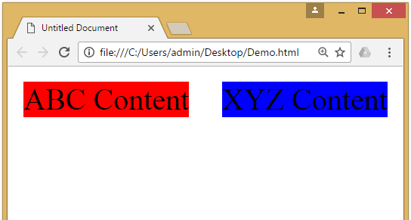
CSS Float Property
The CSS float property defines that an element should be taken out of the normal flow of the document and placed along the left or right side of its containing block.
Text and inline elements will then wrap around this element.
CSS
#division1{
background-color : red;
float : left;
width: 40%;
}
#division2{
background-color : blue;
float : right;
width: 40%;
}
HTML
<div id="division1">
ABC Content
</div>
<div id="division2">
XYZ Content
</div>

Slide 48
Introduction to CSS3
CSS3 is the latest standard for CSS.
CSS3 is completely backwards-compatible with earlier versions of CSS.
CSS3 has been split into "modules". It contains the "old CSS specification" (which has been split into smaller pieces). In addition, new modules are added.
CSS3 Transitions are a presentational effect which allow property changes in CSS values, such as those that may be defined to occur on :hover or :focus, to occur smoothly over a specified duration – rather than happening instantaneously as is the normal behavior.
Transition effects can be applied to a wide variety of CSS properties, including background-color, width, height, opacity, and many more.

Slide 49
Introduction to CSS3 (Cont)
Some of the most important CSS3 modules are:
CSS Animations and Transitions
Calculating Values With calc()
Advanced Selectors
Generated Content and Counters
Gradients
Webfonts
Box Sizing
Border Images
Media Queries
Multiple Backgrounds
CSS Columns
Courtesy : http://tutorialzine.com/2013/10/12-awesome-css3-features-you-can-finally-use/

Slide 50
Animations
CSS animations make it possible to animate transitions from one CSS style configuration to another.
Animations consist of two components,
a style describing the CSS animation
a set of keyframes that indicate the start and end states of the animation’s style, as well as possible intermediate waypoints.
There are three key advantages to CSS animations over traditional script-driven animation techniques:
They’re easy to use for simple animations; you can create them without even having to know JavaScript.
The animations run well, even under moderate system load. Simple animations can often perform poorly in JavaScript. The rendering engine can use frame-skipping and other techniques to keep the performance as smooth as possible.
Letting the browser control the animation sequence lets the browser optimize performance and efficiency by, for example, reducing the update frequency of animations running in tabs that aren't currently visible.

Slide 51
Configuring the animation
To create a CSS animation sequence, you style the element you want to animate with the animation property or its sub-properties. This lets you configure the timing, duration, and other details of how the animation sequence should progress.
Note: This does not configure the actual appearance of the animation, which is done using the @keyframes
The sub-properties of the animation property are:
animation-name : Specifies the name of the @keyframes at-rule describing the animation’s keyframes.
animation-duration : Configures the length of time that an animation should take to complete one cycle.
animation-timing-function : Configures the timing of the animation; that is, how the animation transitions through keyframes, by establishing acceleration curves. (linear, ease, ease-in, ease-out etc…)
animation-delay : Configures the delay between the time the element is loaded and the beginning of the animation sequence.
animation-iteration-count : Configures the number of times the animation should repeat; you can specify infinite to repeat the animation indefinitely.
animation-direction : Configures whether or not the animation should alternate direction on each run through the sequence or reset to the start point and repeat itself. (normal, reverse, alternate etc…)
animation-fill-mode : Configures what values are applied by the animation before and after it is executing.
animation-play-state : Lets you pause and resume the animation sequence.

Slide 52
Defining the animation sequence using keyframes
Once you’ve configured the animation’s timing, you need to define the appearance of the animation. This is done by establishing two or more keyframes using the @keyframes at-rule.
Each keyframe describes how the animated element should render at a given time during the animation sequence.
Example
CSS
p {
animation-duration: 3s;
animation-name: slidein;
}
@keyframes slidein {
from { /* or 0% */
margin-left: 100%;
width: 300%;
} to { /* or 100% */
margin-left: 0%;
width: 100%;
}
}
HTML
<p>
Hello World
</p>

Slide 53
Specifying Intermediate steps
We can specify intermediate steps using percentage of time in @keyframes, similar to the example given below.
HTML
<p>
Hello World
</p>
CSS
p {
animation-duration: 4s;
animation-name: changeColors;
}
@keyframes changeColors {
0% {background-color: yellow;}
25% {background-color: blue;}
50% {background-color: green;}
100% {background-color: red;}
}

Slide 54
CSS Variables / Custom Properties
Custom properties (sometimes referred to as CSS variables or cascading variables) are entities defined by CSS authors that contain specific values to be reused throughout a document.
Advantages of using CSS variables are:
makes the code easier to read (more understandable)
makes it much easier to change.
CSS variables can have a global or local scope.
Global variables can be accessed/used through the entire document.
To create a variable with global scope, declare it inside the :root selector. The :root selector matches the document's root element.
local variables can be used only inside the selector where it is declared.
To create a variable with local scope, declare it inside the selector that is going to use it.
We can use var() function in order to access the variable set in the css.

Slide 55
CSS Variables (Example)
HTML
<p>
Hello World
</p>
<div>
How are you?
</div>
CSS
:root{
--myFavColor : orange;
--myNextFacColor : green;
}
p{
background-color: var(--myFavColor);
color: var(--myNextFacColor);
}
div{
background-color: var(--myNextFacColor);
color: var(--myFavColor);
}

Slide 56
Media Queries
Media queries are a way to target browser by certain characteristics, features, and user preferences, then apply styles or run other code based on those things.
Perhaps the most common media queries in the world are those that target particular viewport ranges and apply custom styles, which is the whole idea of responsive design.
General syntax for the media queries in CSS is,
It consists of:
A media type, which tells the browser what kind of media this code is for (e.g. print, screen etc…).
A media feature, which is a rule, or test that must be passed for the contained CSS to be applied.
A set of CSS rules that will be applied if the test passes and the media type is correct.
Syntax
@media [media-type] ([media-feature]) {
/* Styles! */
}

Slide 57
Media Query (Cont.)
Media Types:
all
print
screen
speech
Media Features:
width & height
min-width, min-height, max-width & max-height
orientation
The viewport meta tag:
<meta name="viewport" content="width=device-width, initial-scale=1.0">
This is needed because by default, most mobile browsers lie about their viewport width.
Non-responsive sites commonly look really bad when rendered in a narrow viewport, so mobile browsers usually render the site with a viewport width wider than the real device width by default (usually 960 pixels), and then shrink the rendered result so that it fits in the display.

Slide 58
Media Query (Example)
CSS
#div1{
background-color: red;
width: 50%;
float: left;
}
#div2{
background-color: yellow;
width: 50%;
float: left;
} @media (max-width: 600px){
#div1{
width: 100%;
}
#div2{
width: 100%;
}
}
HTML
<div id="div1">
Hello
</div>
<div id="div2">
World
</div>
Note: you have to add viewport meta tag in the head section
<meta name="viewport" content=
"width=device-width, initial-scale=1.0">

Slide 59
Media Query (cont.)
We can also use and/or logic in media query, for example
We can use and as a separator if we want two condition to satisfy before applying the CSS.
We can use , (comma) as a separator if we want anyone of the condition to satisfy before applying the CSS.
CSS
@media screen and (min-width: 600px) and (max-width: 900px) {
body {
color: blue;
}
}
CSS
@media (min-width: 600px), (orientation: landscape) {
body {
color: blue;
}
}

Slide 60
Wild Card Selectors
Wildcard selector is used to select multiple elements simultaneously.
It selects similar type of class name or attribute and apply CSS property.
Some of the wild card selector are,
[attribute*=”str”] Selector
It will select all the elements with the given attribute containing the str.
[attribute^=”str”] Selector
It will select all the elements with the given attribute starts with the str.
[attribute$=”str”] Selector
It will select all the elements with the given attribute ends with the str.

Slide 61
Wild Card Selectors
test.css
[data-category*="fruit"] {
color: green;
}
explanation
Selects all elements with the specified attribute (data-category) containing the string "fruit".
test.css
[lang^="en"] {
font-family: 'Arial', sans-serif;
}
explanation
Selects all elements with the specified attribute (lang) starting with the string "en".
test.css
[src$=".png"] {
border: 2px solid black;
}
explanation
Selects all elements with the specified attribute (src) ending with the string ".png".

Slide 62
Gradients
CSS gradients let you display smooth transitions between two or more specified colors.
CSS defines two types of gradients:
Linear Gradients (goes down/up/left/right/diagonally)
To create a linear gradient you must define at least two color stops.
Color stops are the colors you want to render smooth transitions among.
You can also set a starting point and a direction (or an angle) along with the gradient effect.
Radial Gradients (defined by their center)
The radial-gradient() function sets a radial gradient as the background image.
A radial gradient is defined by its center.
To create a radial gradient you must define at least two color stops.

Slide 63
Linear Gradients
To create a linear gradient you must define at least two color stops.
Color stops are the colors you want to render smooth transitions among.
You can also set a starting point and a direction (or an angle) along with the gradient effect.
direction:
to bottom
to top
to right
to left
to bottom left
180deg
Etc…
Syntax
background-image: linear-gradient(direction, color-stop1, color-stop2, ...);

Slide 64

Linear Gradients (Example)
Example:
Output:
CSS
background-image: linear-gradient(red, yellow);

Slide 65
Radial Gradients
To create a linear gradient you must define at least two color stops.
Color stops are the colors you want to render smooth transitions among.
You can also set a starting point and a direction (or an angle) along with the gradient effect.
shape:
Ellipse (defalt)
Circle
size:
farthest-corner (default)
closest-corner
farthest-side
closest-side
position:
Center (default)
Etc…
Syntax
background-image: radial-gradient(shape size at position, start-color, ..., last-color);

Slide 66

Radial Gradients (Example)
Example:
Output:
CSS
background-image: radial-gradient(red, green, yellow);

Slide 67
Pseudo Classes
A pseudo-class is used to define a special state of an element.
For example, it can be used to:
Style an element when a user mouse over it
Style visited and unvisited links differently
Style an element when it gets focus
Some important pseudo classes are:
active
disabled
first-child
nth-child
focus
hover
visited
Syntax
selector:pseudo-class { property: value; }

Slide 68
Pseudo Elements
A CSS pseudo-element is used to style specified parts of an element.
For example, it can be used to:
Style the first letter, or line, of an element
Insert content before, or after, the content of an element
pseudo elements are,
after
before
first-letter
first-line
selection
Syntax
selector::pseudo-element { property: value; }

Slide 69

Web Technology-I
DU#2301CS363
Prof. Dharmik P Vasiyani
Computer Engineering Department
dharmik.vasiyani@darshan.ac.in
9924664064

